Slide 1
PRESENTATION TITLE
Kunal Sridharan

Slide 2
AGENDA
Introduction​
Data Exploration & Understanding
​Handling Missing Values
Standardize Numerical Features
​Feature engineering
Model Selection and Training
​

Slide 3
Introduction
SMART INDIA HACKATHON
(SIH) CHALLENGE SET
The "Smart India Hackathon Problem Statements Dataset" is a comprehensive collection of problem statements sourced from various esteemed organizations participating in the Smart India Hackathon. This dataset encompasses essential details such as serial numbers, the originating organization, titles of the problem statements, their associated categories, unique problem statement numbers, the count of submitted ideas for each problem, and the domain bucket to which the problems belong.

Slide 4
PRIMARY GOALS
Enhance problem-solving and innovation

Slide 5
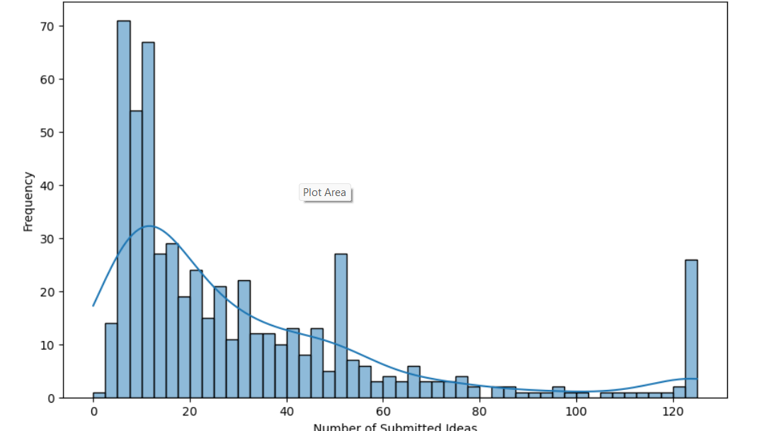
Distribution of submitted ideas

Slide 6
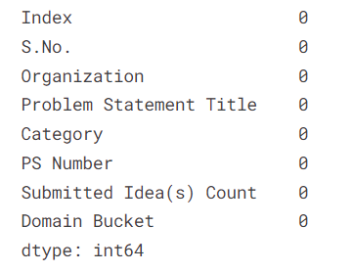
Handling Missing Values

Slide 7
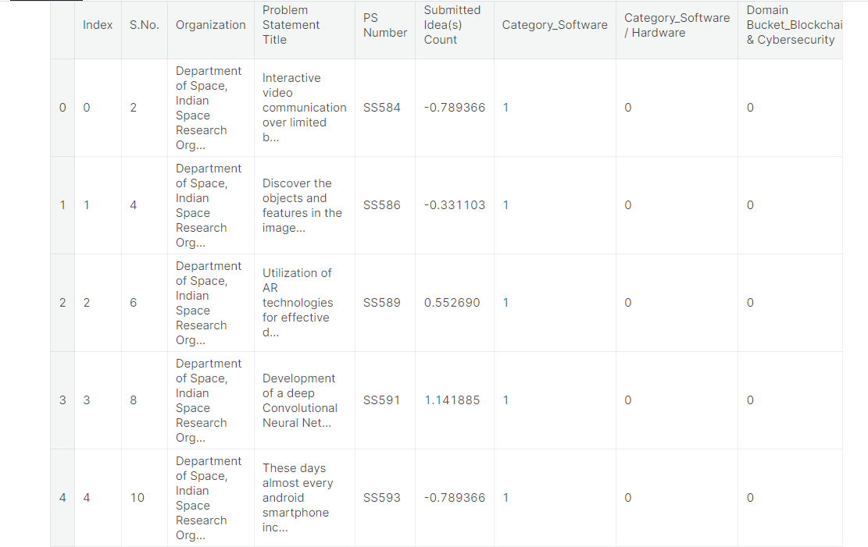
Standardize Numerical Features

Slide 8
AREAS OF FOCUS Problem Category Sorting Idea Popularity Prediction Idea Clustering Trend Tracking Domain Insights Org. Behavior Analysis Collaboration Discovery Sentiment Analysis

Slide 9
SUMMARY
The "Smart India Hackathon Problem Statements Dataset" serves as a valuable resource for researchers and data enthusiasts to explore trends, patterns, and opportunities within the hackathon landscape, while also fueling the development of practical machine learning and data science applications to enhance problem-solving and innovation.

Slide 10
THANK YOU
Kunal Sridharan
https://github.com/KunalSridharan

